Slide 1

CQUIN e-learning package
Vitamin D
Elaine Burfitt
Consultant Community Paediatrician
Amy Wilson
Paediatric Specialist Registrar
Notes:
Good morning and thank you for inviting us to present today.
I am a community paediatrician working in Salford and Amy is a paediatric trainee who was based in Salford last year.

Slide 2
CQUIN e-learning package
Vitamin D
Its place in the Salford story
The CQUIN
What the e-learning package covers
Some example slides
Notes:
Over the next 15 minutes we are going to tell you about the Vitamin D e-learning package that we are now using for Salford Royal staff.
I am going to briefly give you some of the background to how it came about and then Amy is going to take you through what the package covers and show you about 10 of the 55 slides that form the e-learning module.

Slide 3
Clinical research and national guidance
Implementation
Availability of vitamins
Education of staff
Education of parents
Guidelines for treatment of severe deficiency
Notes:
As with many things in medicine we aim to start with clinical research and national guidance. In the case of vitamin D deficiency one of the world experts is Dr Zulph Mughal who is based here in Manchester at the children’s hospital. The most powerful national guidance came in February 2012 in the form of a letter from the Chief Medical Officer to all Drs in England recommending Vitamin D supplementation to all pregnant and breastfeeding women and children up to 5 years.
These guidelines then need to be implemented locally and in Salford, as you will see in a minute, we have historically concentrated of availability of the vitamins at as many venues as possible.
In the last few years more emphasis has been placed on the education of staff and in turn education of parents via direct contact. This e-learning module of course is aimed to address this area.
As part of the overall picture clinicians need to know the best way to treat severe deficiency if that should be found, and in the last few months we have had more clear guidance in this area and this has been written locally.

Slide 4
Salford story – Vitamin D
Eccles Health Centre and Healthy Start vitamins
Health Centre roll out
Vitamins in Infant feeding policy
2010 - availability at Children’s Centres
2012 - audit of availability
2012 - linked with breast feeding training
2013 – e-learning CQUIN
2013 - Future big news I hope
Notes:
So in Salford at the time of my first case of rickets which was around 2005, 2006 there was at the time a change over from the old welfare food scheme to Healthy Start. In 2006 I located Salford’s only supply of Healthy Start vitamins in Eccles Health Centre where the senior clerk, Debbie Drinkwater was doing valiant job of supplying the health visitors attached to that centre.
It was Debbie who told me about Healthy Start and with her help we rapidly rolled this out to all the health centres in Salford.
An opportunity arose when I met Magda Sachs who was writing the local infant feeding policy in the Public Health department. It wasn’t long before Magda became a convert to the vitamin D cause and included the need for supplements in that policy. Magda then instigated the rolling out to all the children’s centres in Salford along with training for the local authority staff at the centres.
More cases of rickets were still coming along and in 2012 I became aware that still some health visitors and children’s centres were more engaged than others. Dr Amy Wilson had just started her 12 month post in Salford and was already interested in the subject so was happy to audit the availability of vitamins at children’s centres, health centres and particularly antenatal clinics which was confirmed as being poor.
The education of professionals was linked to the class based mandatory breast feeding training for health visitors but as this was being carried out by only one person, Magda, it was not really that sustainable or time efficient, not least for Magda.
An e-learning module was felt to be the way forward as this would be more accessible by a wider number of staff groups and new starters. It was decided to make it into a CQUIN hence the importance attached to it without the potential issues attached to mandatory training.
The future big news goes back to the area of availability which has become even more important since the spring this year when we were directed to stop selling the vitamins. There is a proposal for universal provision for women and children as per the CMOs national guidance up until 4 years of age. This is going through the various meetings of the CCG process and I am hopeful for good news in early October.

Slide 5
CQUINS
Financial investment/incentive for providers to achieve a target
Commissioner agrees activity or new development with provider service
Payment received by provider for achieving agreed action in agreed timescale
Notes:
So for those of you not familiar with cquins it stands for commissioning for quality innovation.
In practice this is a financial incentive to successfully meet a target.
The target needs to have been agreed between the commissioner and the provider service, in this case SRFT children’s directorate.
And then the directorate gets paid for achieving that target

Slide 6
Vitamin D e-learning CQUIN
20% for e-learning module being written to standard approved by CCG in Quarter 1
70% for all eligible staff trained by end of Quarter 4
10% for agreed increase in uptake (measured by voucher redemption)
Notes:
In this case for 20% of the payment we needed to have the e-learning module created and approved by a meeting of the CCG in June which we did thanks to a lot of hard work from Amy in creating the power point. Local authority commissioners were also part of that meeting and are interested in using it to educate their own staff.
We now are in the phase of training all eligible staff by the end of the financial year which has the largest proportion attached to it.
Achieving the last 10% may be a challenge as it is not directly under our control but of course it is fundamental to what we are trying to achieve. In order to be able to measure uptake we can only currently do this for the group of children eligible for vouchers but of course we aim to increase uptake for all children.

Slide 7
Vitamin D training
Paediatricians
Health Visitors
School nurses
Dieticians
Children’s A&E and acute children’s nurses
Physiotherapists
Discussions regarding possible use in the local authority
Notes:
And these are the staff groups in Salford Royal who are doing this e-learning module.
I will now hand you over to Amy who will take you through the module itself.

Slide 8
The e-learning package
Setting the scene
Learning objectives
  Role of Vitamin D in health
  Sources of Vitamin D
  At risk groups
Treasure chests
Self assessment questions
Notes:
At the start of the package we wanted to emphasize the size of the problem and therefore the relevance of this package to everyday practice- why should I do this?
We created learning objectives to clarify the important points.
Treasure chests are included throughout the package. These provide a link to more in depth information in that particular subject area. They are not compulsory. The aim was to keep the package focused on the important key messages and not go into too much detail, yet to provide further information for those who were particularly interested. We felt this made the package more accessible to a wider range of health professionals.
Throughout the package there are self assessment questions to emphasize particular points. These marks are not recorded but are for the learners own information.

Slide 9
Topics covered
Role of Vitamin D in health
  Including symptoms of deficiency
Sources of Vitamin D
  Food, sunlight and supplementation
At risk groups
Department of Health recommendations
  Including the Healthy Start scheme
Notes:
These stem from the learning objectives.
There is information about the role of vitamin D and how deficiency can affect different body systems.
Different natural sources of Vitamin D are covered but the point that for some groups ie pregnant women, young children and the elderly this is not enough. The package also covers the various genetic, cultural, religious and lifestyle practices which may put people at higher risk of Vitamin D deficiency. The current government recommendations for vitamin D supplements is therefore outlined.

Slide 10

Vitamin D

Slide 11

Some pages will have a treasure chest symbol
Click on this to access more detailed information about that subject and references

Slide 12
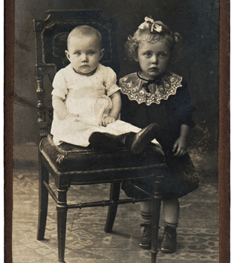
Quick Quiz
Vitamin D deficiency is present in what percentage of the population in Britain today?
  1%
  3%
  7%
  15%
  >25%
  YES- >25%!!!

Slide 13


Sunlight- advice
However:
Too much exposure to the strong sun can be damaging.
Sunburn should be avoided (mainly because it increases the risk of skin cancer)
Children should wear sun screen to prevent sun burn
Further North than 52 degrees latitude (Gloucester), there is not enough UVB rays in sunlight necessary to make vitamin D between October and April
Many people in the UK are therefore at risk of not getting enough vitamin D unless they get it in their diet and supplements
Notes:
Treasure chest- needs hyperlink to PDF file 4 (containing extra sunlight advice)

Slide 14

Re-emergence of rickets
This is the reason you are doing this training on vitamin D
There is an emerging problem in Salford
We need to make sure frontline staff are fully aware of the issues…
…and what to do about them!

Slide 15



Who is at risk of Vitamin D deficiency?
ALL OF US!

Slide 16
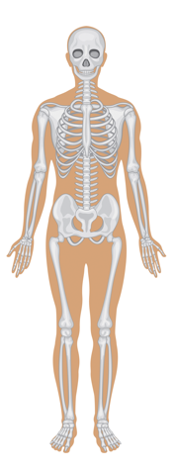
Vitamin D deficiency
Can cause rickets in babies and children
Severe deficiency affecting the bones in babies and children is called rickets and may lead to
  soft skull
  bowing of the legs
  Bones can break more easily

Slide 17
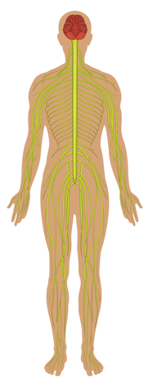
Vitamin D deficiency
Can cause low calcium which can
  lead to seizures
  be life threatening
1 child per week has a seizure due to vitamin D deficiency in the UK

Slide 18


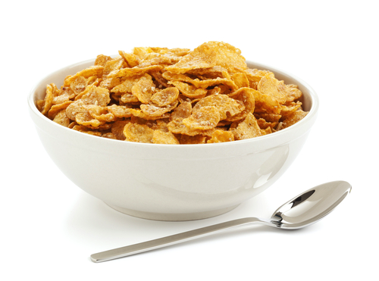
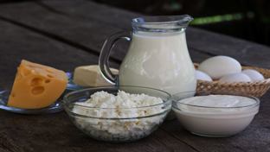
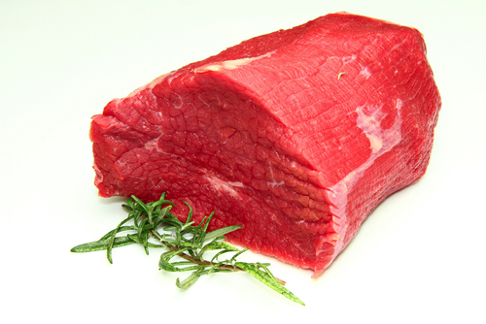

Do you know which of these contain Vitamin D?
No- Green beans do not contain vitamin D
Yes- breakfast cereals are fortified with vitamin D
No- Red meat does not contain vitamin D
Yes- egg yolk does contain vitamin D
Yes- dairy products do contain vitamin D
Yes- mushrooms do contain vitamin D

Slide 19

Department of Health
The chief medical officers recommend that:
All pregnant and breastfeeding women should take a daily supplement containing 10μg of vitamin D
All infants and young children aged 6 months to 5 years should take a daily supplement of vitamin D
Infants who are formula fed will not need vitamin drops until they are receiving less than 500ml of formula a day
Breastfed infants may need to receive drops containing vitamin D from one month of age if their mother has not taken vitamin D supplements throughout pregnancy.
People aged 65 years and over and people who are not exposed to much sun should also take a daily supplement containing 10 micrograms of vitamin D.

Slide 20

Quick Quiz
A 17 year old girl is pregnant with her first child. She has bought folic acid tablets and is taking them. What advice would you give her about vitamins in pregnancy?
  She should take a supplement containing vitamin D designed for pregnant women
    She would be eligible for free Healthy Start vitamins as she is under 18
    They contain both vitamin D and folic acid

Slide 21
CQUIN e-learning package
Vitamin D
Thank you

